Slide 1
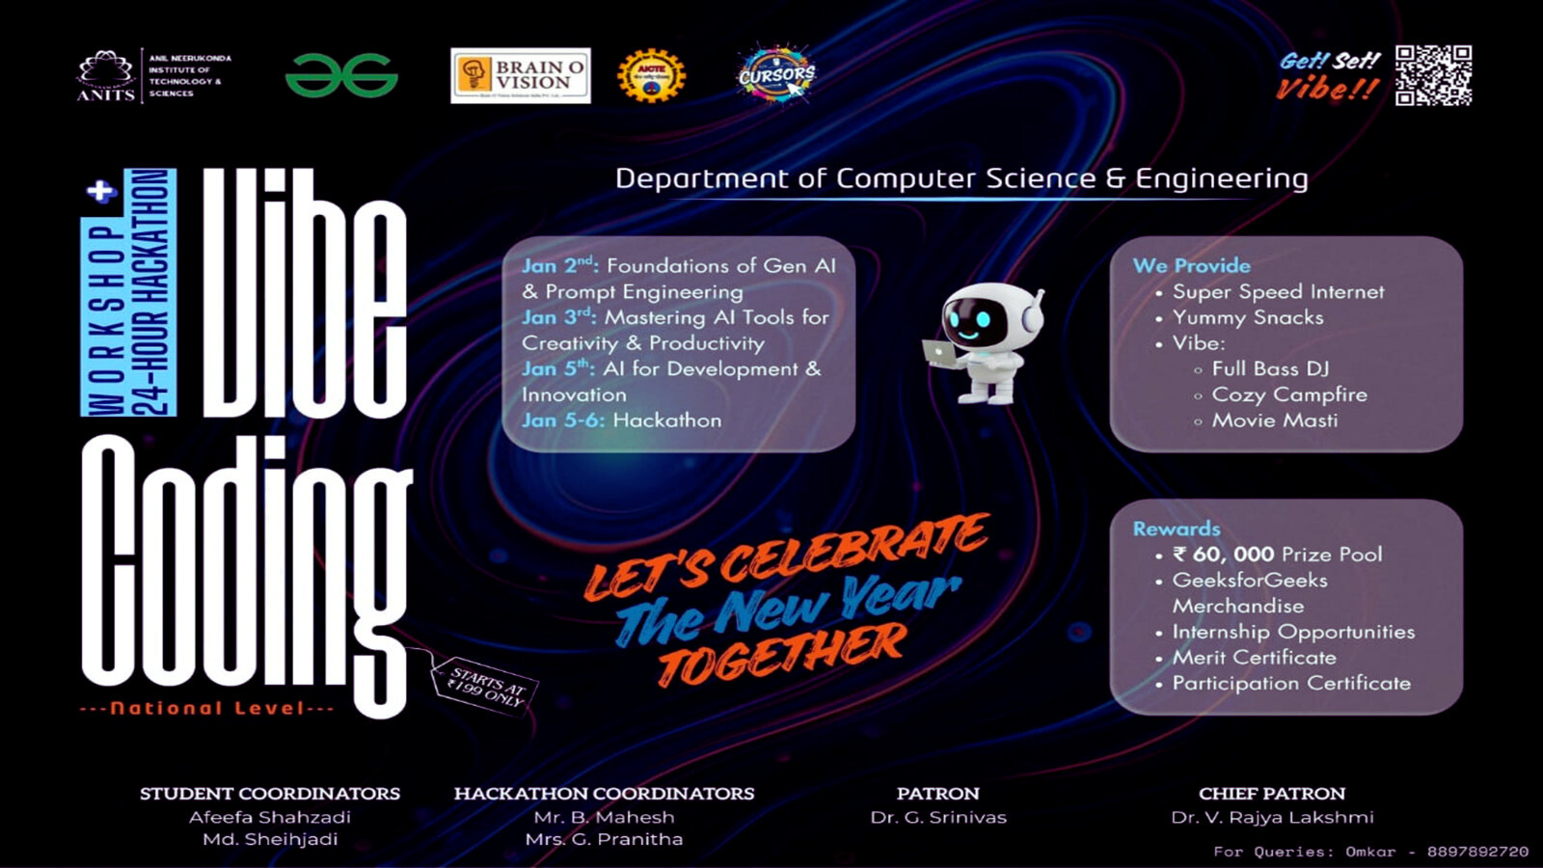

Slide 2


SAVE SMART
Title :
AI-Based Expense Tracker with Smart Financial Insights
An Intelligent Financial Management Solution.

Slide 3


Problem Statement:
Many individuals struggle to track their daily expenses and understand their spending habits. Manual tracking is time-consuming and lacks insights, leading to poor budgeting and financial planning.

Slide 4
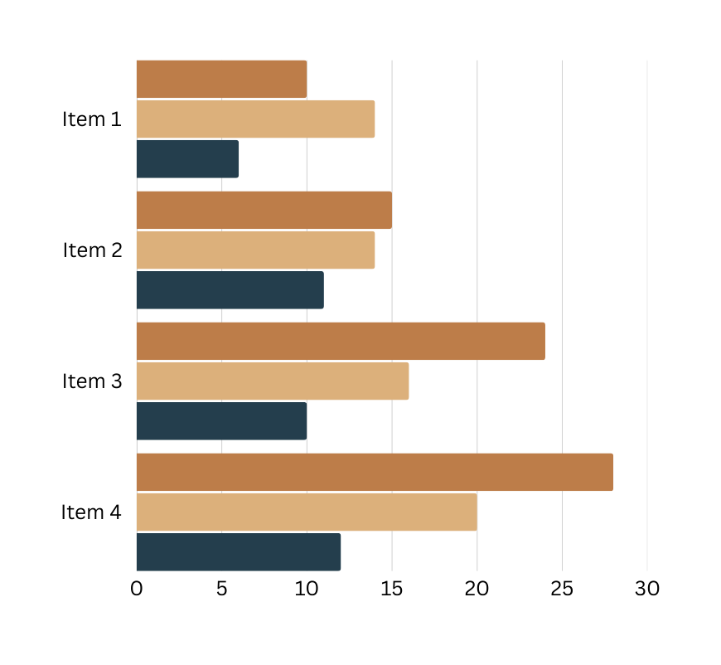
Technologies Used:
Frontend: Web / Mobile Application.
AI Tools Used: Gemini AI, DeepSeek , ChatGPT , Replit.
Security: Encrypted data storage.

Slide 5

Challenges Faced During the Hackathon:
Performance Delay :The website was slow to respond to user actions, causing delays in loading pages and executing features, which affected the overall user experience.
Slow Updates & Sync Issues: Changes and updates took a long time to reflect on the website, leading to outdated information being shown to users.
Feature Search Difficulty: Users faced difficulty in locating specific features due to poor navigation structure and lack of an effective search or filter option.

Slide 6

Solution Towards The Challenge:
An intelligent expense tracking application that uses AI to categorize expenses, monitor income, predict future spending, and provide smart alerts and recommendations for better financial decisions.

Slide 7

Your Uniqueness In The
Application:
AI-Driven Personalized Insights
Predictive Expense Analysis
Smart Budget Recommendations
Anomaly and Overspending Detection
Actionable Recommendations, Not Just Reports

